Slide 1

20EC5203 ELECTRONIC DESIGN PROJECT- I
Presented by:
SANJAY A
Electronics and communication engineering
r

Slide 2
OUTLINE
ABSTRACT –MODULE 1
INTRODUCTION
OBJECTIVE AND SCOPE
BLOCK DIAGRAM AND
HARDWARE MODULE
ADVANTAGES AND APPLICATIONS
ABSTRACT –MODULE 2
INTRODUCTION
OBJECTIVE AND SCOPE
BLOCK DIAGRAM
HARDWARE MODULE
ADVANTAGES AND APPLICATIONS
CONCLUSION
REFERENCES

Slide 3
MODULE 1 – WIRE BREAK ALARM SYSTEM

Slide 4
ABSTRACT - MODULE 1
The Wire Break Alarm System is a simple yet effective mini-project designed to detect and alert when a wire in a circuit is broken or tampered with. It works by continuously monitoring the continuity of a wire using a basic electrical circuit. When the wire breaks or is disconnected, the circuit triggers an alarm, notifying users of the disruption. This system finds applications in security, industrial monitoring, and ensuring the integrity of critical connections. Its compact design, cost-effectiveness, and reliability make it ideal for educational purposes and small-scale practical implementations in safeguarding wired networks.

Slide 5
INTRODUCTION – MODULE 1
A wire break alarm system is a simple yet effective security mechanism designed to detect and alert users to interruptions in a circuit. This system is commonly used in fencing, perimeter security, or industrial setups to safeguard properties and equipment. It works by continuously monitoring the integrity of a wire loop; any break in the wire triggers an alarm, signaling a breach or fault. This project combines fundamental electrical principles with practical applications, providing a reliable and cost-effective solution for security concerns. Its straightforward design ensures ease of implementation, making it ideal for DIY enthusiasts and professional installations alike.

Slide 6
OBJECTIVE
The objective of the wire break alarm system project is to design a device that detects physical interruptions or breaks in a wire, triggering an alert. It aims to ensure timely identification of wire faults in applications such as security systems, industrial setups, or electrical circuits to prevent damage or failure.
SCOPE
The wire break alarm system project aims to detect interruptions or breaks in electrical wiring, triggering an alarm to alert users of potential faults. This system is crucial for applications in security, industrial machinery, or electrical systems, ensuring early detection and preventing potential damage or hazards from unnoticed wire failures.

Slide 7
LITERATURE SURVEY
REF. NO. | TITLE & AUTHOR | METHODOLOGY & COMPONENTS USED | PROS | CONS
1 | Crack Detection System using Image Processing Techniques Author: S. S. Rao et al. | Image acquisition using camera Image processing using OpenCV library Crack detection using thresholding and edge detection algorithms. | High accuracy in crack detection Real-time monitoring possible | Limited to surface cracks only Requires high-quality images
2 | Design of Classroom Wireless Fire Monitoring and Alarm System Based on Author: Y. Zhang et al. | CC2530 wireless module for communication Temperature and smoke sensors for fire detection Microcontroller: MSP430F2274 Wireless communication protocol: Zigbee | Real-time monitoring and alert system Low power consumption | Limited range of wireless communication Interference from other wireless devices possible
3 | Online Monitoring System of Cable Based on Microchip Author: L. Wang et al. | Microchip 51 microcontroller for data acquisition and processing Sensors for temperature, humidity, and vibration monitoring GPRS module for online data transmission | Real-time online monitoring possible Remote monitoring and alert system | High cost of implementation Dependence on internet connectivity
4 | Controller Design of Smart Light Pole Equipment Box Author: J. Li et al. | STM32 microcontroller for control and monitoring Sensors for temperature, humidity, and light monitoring Wi-Fi module for remote monitoring and control | Real-time monitoring and control possible Energy-efficient lighting system | High complexity in implementation Cybersecurity risks associated with Wi-Fi connectivity
5 | The design and performance of an in-car misfire warning light system Authors: W.J.Jhonson | To detect misfires, a microcontroller for processing, and an LED or dashboard indicator as the warning light. The engine’s operational data is analyzed in real-time. | Early detection of misfires prevents engine damage. Improves safety by alerting drivers promptly. | Can produce false positives due to sensor errors increasing cost and complexity.

Slide 8
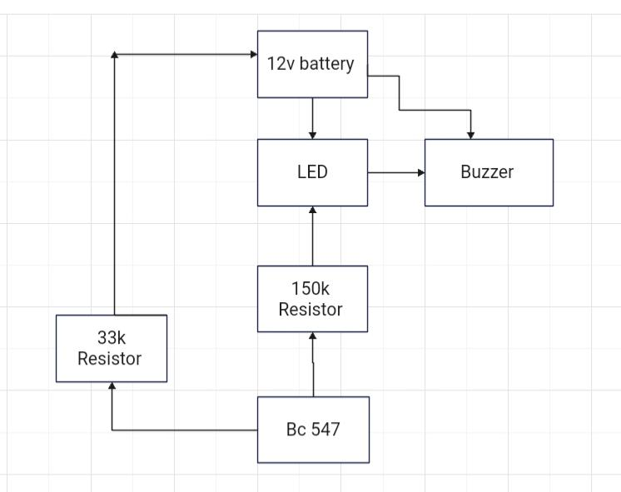
BLOCK DIAGRAM

Slide 9
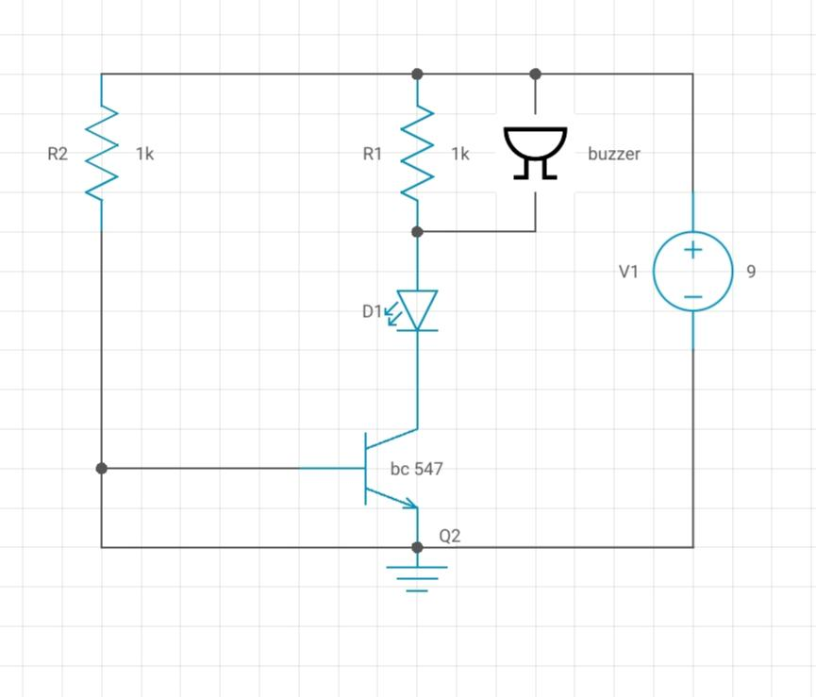
CIRCUIT DIAGRAM

Slide 10
HARDWARE MODULE
Bread board
BC 547 transistor
2.2k , 680ohms resistor
LED
Buzzer
9v battery

Slide 11
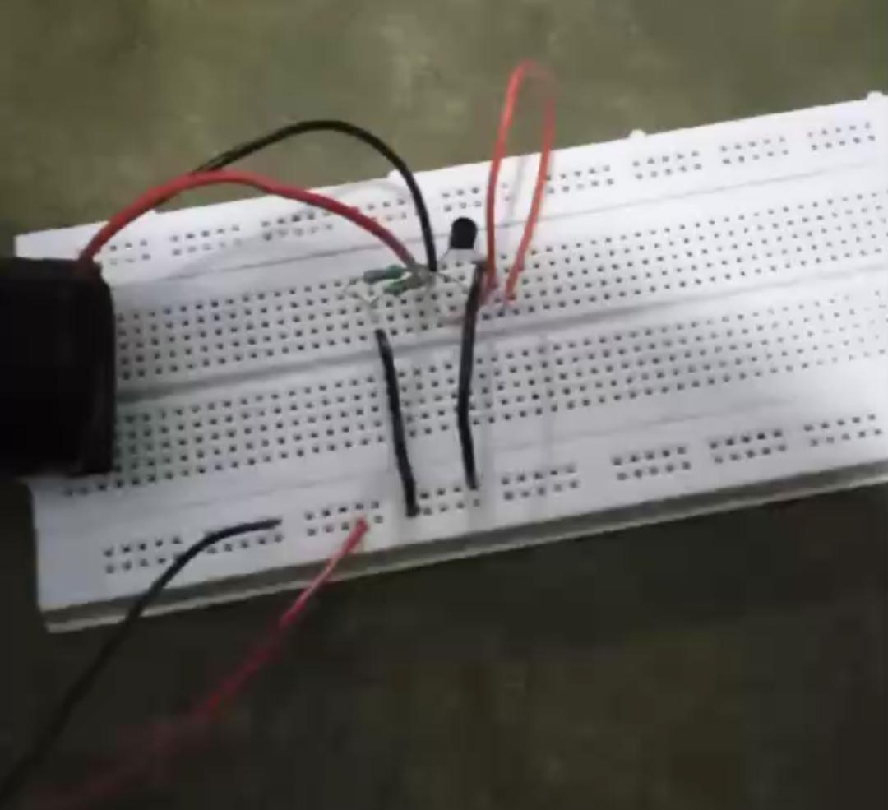
WORKING MODULE
https://drive.google.com/file/d/1Ao4L9Bh0niCFDS_eBSno1QNS_IgwaA97/view?usp=drivesdk

Slide 12
ADVANTAGES AND APPLICATIONS
ADVANTAGES
It is relatively easy to install and simple design.
These systems are generally affordable at low cost.
These systems typically require less power, making them more energy-efficient.
APPLICATIONS
Perimeter Security.
Power Line and Cable Monitoring.
Home and Office Security.
Industrial Equipment Monitoring.

Slide 13
MODULE 2 – CAR REVERSE PARKING SYSTEM

Slide 14
ABSTRACT - MODULE 2
The Car Reverse Parking Sensor is an essential safety device designed to assist drivers in parking and reversing vehicles. The system employs ultrasonic sensors to detect obstacles behind the car and measures the distance in real-time. Upon detecting an object, it provides audible and visual alerts to the driver, helping to prevent collisions and ensuring safer parking, especially in tight spaces. The project integrates hardware components such as ultrasonic sensors, a microcontroller, and a buzzer or display. By enhancing awareness of the vehicle’s surroundings, this cost-effective and user-friendly solution promotes safety and convenience for drivers in everyday parking scenarios.

Slide 15
INTRODUCTION – MODULE 2
The Car Reverse Parking Sensor is a practical and innovative project designed to enhance vehicle safety by assisting drivers during reverse parking. This system uses ultrasonic sensors to detect obstacles behind the vehicle, providing real-time feedback to the driver through visual or audio alerts. By measuring the distance between the car and nearby objects, it helps prevent collisions, ensuring a safe and stress-free parking experience. Ideal for both novice and experienced drivers, this project integrates technology with user-friendly functionality. Its implementation demonstrates the principles of sensor integration, microcontroller programming, and system design, making it a valuable addition to modern automotive safety solutions.

Slide 16
OBJECTIVE
The objective of this project is to design and implement a reverse parking sensor system that enhances vehicle safety. Using ultrasonic sensors, it detects obstacles behind the car, calculates their distance, and provides real-time audio-visual feedback to the driver, helping to prevent collisions and improve parking precision in tight spaces.
SCOPE
The car reverse parking sensor project aims to enhance vehicle safety by providing real-time obstacle detection and proximity alerts. This system can reduce accidents during parking, especially in tight spaces. It offers scope for innovation in sensor technology, signal processing, and integration with modern automotive systems, ensuring improved convenience and user experience.

Slide 17
LITERATURE SURVEY
REF. NO. | TITLE & AUTHOR | METHODOLOGY & COMPONENTS USED | PROS | CONS
1 | Design of Reverse Search Car System for Large Parking. Author: J. Kim et al. | NFC tags for vehicle identification NFC readers for parking lot navigation Mobile app for user interface Server for data storage and processing. | Efficient parking space allocation Reduced parking time. | High cost of NFC tag installation<br>* Limited range of NFC readers
2 | Car-Like Mobile Robot Reverse Parking. Author: A. K. Singh et al. | Fuzzy logic controller for parking Ultrasonic sensors for obstacle detection DC motors for robot movement Microcontroller: Arduino Mega. | Smooth and efficient parking maneuver Real-time obstacle detection | Limited to small-scale parking lots Requires precise calibration of sensors
3 | Vision-Based Parking Assist System with Bird-Eye Surround Vision for Reverse parking. Author: Y. Liu et al. | Camera system for bird-eye view generation Image processing for parking space detection Parking maneuver recommendation algorithm Display unit for driver assistance. | Accurate parking space detection Real-time parking maneuver recommendation | High computational requirements Limited to well-lit parking environments
4 | Autonomous Car Parking System using Fuzzy Logic. Author: S. K. Singh et al. | Fuzzy logic controller for parking maneuver Ultrasonic sensors for obstacle detection GPS system for autonomous control. | Autonomous parking capability Real-time obstacle detection | High complexity in implementation Requires precise calibration of sensors and actuators
5 | Electric Car with Assistive Parking. Authors:Muhammad Taha | Combines sensor-based systems, machine learning, and real-time data processing. Ultrasonic sensors, cameras, and LIDAR detect surroundings. | Reduces parking effort and accidents. Supports eco-friendly transportation. | High initial cost Complex systems. Dependence on clear surroundings for accuracy.

Slide 18
BLOCK DIAGRAM
3.7 v battery
transistor BC547
buzzer
photo diode
resistor 15K
IR LED

Slide 19
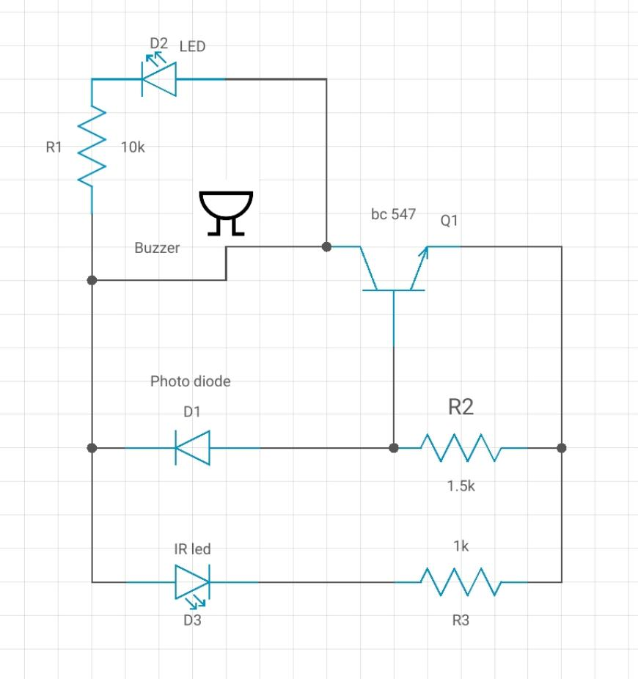
CIRCUIT DIAGRAM

Slide 20
HARDWARE MODULE
IR LED resistor 1K,2.6K,15K buzzer 3.7 v battery transistor BC547 photo diode

Slide 21
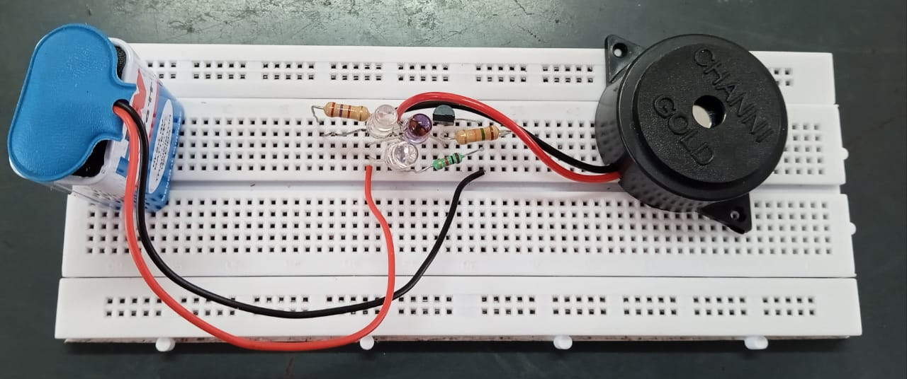
WORKING MODULE
https://drive.google.com/file/d/1AqkW8GmtvEOvP_HG8Hek1Ac94AVhLNxZ/view?usp=drivesdk

Slide 22
ADVANTAGES AND APPLICATIONS
ADVANTAGES
Enhanced Safety and Damage Prevention.
Ease of Parking.
Assistance in Low Visibility.
Improved Parking Efficiency and occurancy.
APPLICATIONS
Obstacle Detection.
Traffic Assist in Tight Spaces.
Automated Parking Systems.

Slide 23
CONCLUSION
The wire break alarm system successfully detects any disruptions in the connected wires, providing timely alerts through a buzzer or notification. It ensures prompt responses to wire faults, enhancing safety and reliability in various applications, including security systems and industrial monitoring, while being cost-effective and easy to implement.
The car reverse parking sensor project successfully enhances vehicle safety by providing audible alerts to the driver when objects are detected behind the car. It effectively reduces the risk of accidents and damage while reversing, offering an affordable and efficient solution to improve parking accuracy and overall driving experience.

Slide 24
REFERENCES
F. Barrero, J. A. Guevara, E. Vargas, S. Toral and M. Vargas, “Networked Transducers in Intelligent Transportation Systems Based on the IEEE 1451 Standard”, Computer Standards & Interfaces, vol. 36, no. 2, pp. 300-311, 2014.
H. Cai-mei, H. Zhi-kun, Y. Yue-feng, W. Jian and Y. Ruo-nan, “Design of reverse search car system for large parking lot based on NFC technology.
W. G. Rado and W. J. Johnson, “Monitoring the Combustion Quality in Internal Combustion Engines Using the Spark Plug as a Plasma Probe.
Wang Huimin, Design of Urban Parking Guidance SystemDesign of Urban Parking Guidance System [D], Nanjing University of Information Technology, 2014.
W. J. Johnson and W. G. Rado, “Engine Performance Evaluation Using A Combustion Probe Signal Analyzer.

Slide 25
REFERENCES
X. –Z. Yang and Z. –Q. Zhou, “Design of Crack Detection System,” 2017 International Conference . Y. Li, Y. Lei and M. Wang, “Design of Classroom Wireless Fire Monitoring and Alarm System Based on CC2530. Z. Liu, Y. Wang and T. –F. Lu, “Car-Like Mobile Robot Reverse Parking: Using Fuzzy Logic Control Approach,” 2011. Z. Li, X. Li and T. Zhang, “Design of Parking Guidance and Reverse Car-Searching System based on Barcode,” 2022 Zhou Zhiyong, Chen Jun and Wang Wei, “A Review of Development and Application of Urban Parking Guidance Information System [J]”, Transportation Systems Engineering and Information(2012).

Slide 26
THANK YOU

